Slide 1
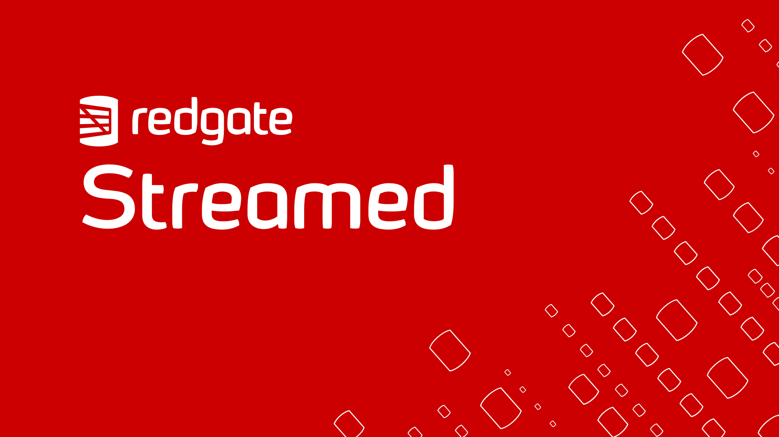

Slide 2

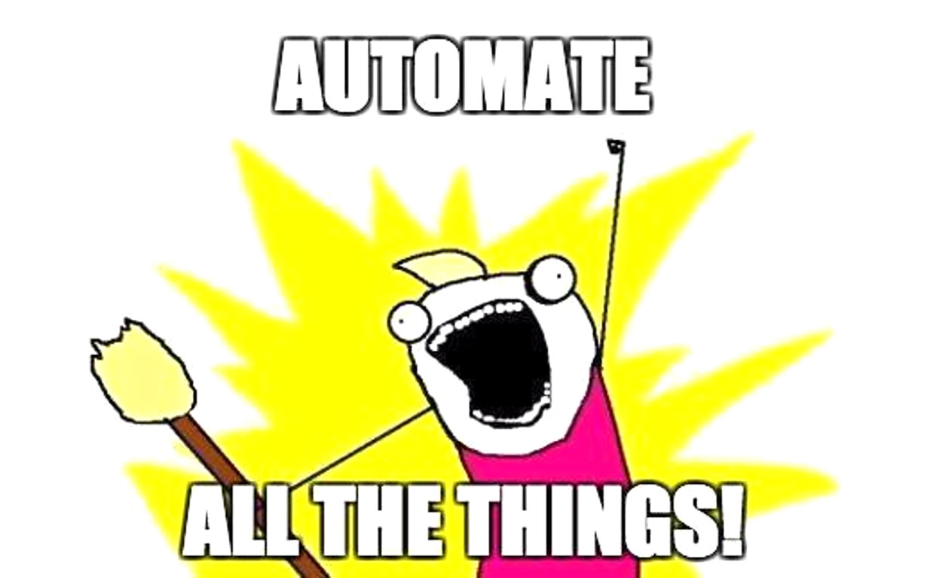
Clone ALL the things!
How Database clones can enable faster delivery of value in your DevOps pipeline.

Slide 3






About me
Chris Unwin
Solutions Architect
Redgate Software
@PlantBasedSQL
www.plantbasedsql.com
DBAle on Spotify

Slide 4

Goal
To understand how database cloning can help ensure value in, and speed up a database change management pipeline (Source Control, Continuous Integration and Continuous Delivery).
Notes:
Photo: https://unsplash.com/photos/yPpMuUXm78A

Slide 5
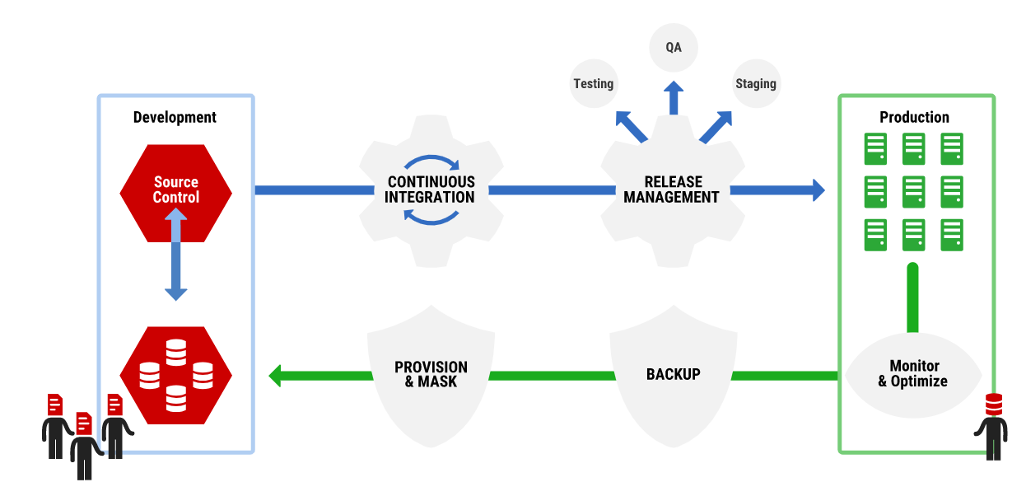

A bit of background on database DevOps

Slide 6
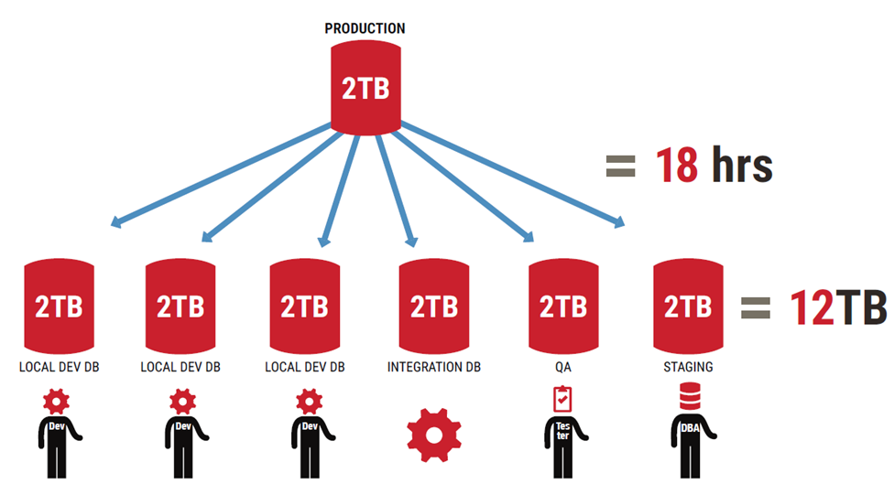
Wait. Back-up!

Slide 7

What is SQL Clone?
A simple approach to get started with standardizing development practices
An excellent way to save on space in non-Production environments and time required to create 40mb copies
A system for leveraging the Volume Shadow Copy Service (VSS) in 64-bit Windows to virtualise a central copy
Additional Data Masking element allows rapid de-identification of sensitive data
Completely automated with PowerShell
Give everyone their own dedicated databases… for everything.

Slide 8

Basically it’s a really cool way to create databases.

Slide 9

SQL Clone in action

Slide 10

“Wow this Clone stuff is pretty neat.”
- Everyone.

Slide 11
But it’s not just dedicated environments

Slide 12

Baseline.
Keep your demons at bay.
Invalid objects, linked servers, circular dependencies and more plague our legacy database
No need to rework baseline migration scripts
Clones can be used for script validation / shadow databases
Cloning feeds through to the build automatically
Easier and faster getting started with your existing databases

Slide 13
But it’s not just dedicated environments

Slide 14

Branching.
Keep your work separate.
Use Githooks in your local repo
Spin up a new environment for each new branch
Swap between environments seamlessly
Minimal waiting involved for developers
The database is just as agile as the code

Slide 15
But it’s not just dedicated environments

Slide 16

Pull Requests.
Keep code quality high.
Approving PRs is hard if we don’t have a live environment to test against
Plug in to your existing workflow e.g. Azure DevOps
Build and Deploy automatically to a Clone with Redgate Change Automation
No need to rollback changes or review a ‘screen of code’, just blow the clone away

Slide 17
But it’s not just dedicated environments

Slide 18

Release Candidates.
Know what will happen.
No need for lots of outdated pre-Production environments
Validate with Continuous Delivery to a Clone
Ensure what goes out is representative of Version Control
No need to rollback testing environments

Slide 19

Want to know more?
Webinar with Kendra: https://www.red-gate.com/hub/events/online-events/the-future-of-devops-fully-left-shifted-deployments-with-version-control-and-automatic-cloning
Documentation: https://documentation.red-gate.com/sca/developing-databases/concepts/baseline/using-a-sql-clone-image-as-a-baseline
Product Article (Branch Switching): https://www.red-gate.com/hub/product-learning/sql-clone/how-sql-clone-and-sql-change-automation-enable-seamless-database-branch-switching

Slide 20

Questions / Comments
Notes:
We won’t use this slide in the webinar unless anyone asks a related question
We do have a client to use this slide with ☺
3 components to secure targets in Legacy TFS / Azure DevOps…
Control who can create new pipelines: Create an Agent Pool for Production SQL Server Instances and use the security properties on the agent pool to limit who can create pipelines using that agent pool. For those who need to see the progress of pipelines/monitor deployments, there is a ‘Reader’ role.
Effect: This prohibits users from accidentally creating pipelines which deploy to production or implementing a quick new pipeline “workaround” without proper approval
Control what the agent can do: When the agent is installed on the production SQL Server, the agent pool is configured, as well as the account used by the agent. This account can be tailored to only have permissions to that SQL Server instance (or a subset, as long as you ensure that it has permissions for the code you will be deploying).
Effect: Should people be concerned about the agent being used to communicate with other SQL Instances across the network in production, this limits the scope of what can be done from the agent.
Control what can be done within an existing release pipeline: there are two configurable areas here:
Who can run vs edit vs view the pipeline: Pipeline security can be configured to allow people to interact with an existing pipeline in many different ways – for instance to be able to execute the pipeline but not edit the definition
Approvals within the pipeline: Stages may be edited to set approvals, such as a pre-approval step before a production deployment of a release artifact (or wherever desired)

Slide 21

Notes:
We won’t use this slide in the webinar unless anyone asks a related question
We do have a client to use this slide with ☺
3 components to secure targets in Legacy TFS / Azure DevOps…
Control who can create new pipelines: Create an Agent Pool for Production SQL Server Instances and use the security properties on the agent pool to limit who can create pipelines using that agent pool. For those who need to see the progress of pipelines/monitor deployments, there is a ‘Reader’ role.
Effect: This prohibits users from accidentally creating pipelines which deploy to production or implementing a quick new pipeline “workaround” without proper approval
Control what the agent can do: When the agent is installed on the production SQL Server, the agent pool is configured, as well as the account used by the agent. This account can be tailored to only have permissions to that SQL Server instance (or a subset, as long as you ensure that it has permissions for the code you will be deploying).
Effect: Should people be concerned about the agent being used to communicate with other SQL Instances across the network in production, this limits the scope of what can be done from the agent.
Control what can be done within an existing release pipeline: there are two configurable areas here:
Who can run vs edit vs view the pipeline: Pipeline security can be configured to allow people to interact with an existing pipeline in many different ways – for instance to be able to execute the pipeline but not edit the definition
Approvals within the pipeline: Stages may be edited to set approvals, such as a pre-approval step before a production deployment of a release artifact (or wherever desired)

